Slide 1
Questions about the painting: Location, date, and significance
Reinventing Culture in East Asia
EASIA 237

Slide 2
Today’s lecture
Assigned reading & research articles in academic journals (2-3)
Northern and Southern Song history (4-6)
  What does this have to do with the Qingming Scroll?
Three perspectives (7–11)
  Hansen: Idealized city, nostalgia for fallen north in 12th century
  Tsao: Spring in Kaifeng, before 1079
  Yu Hui: Kaifeng to critique of N. Song & policies of Emperor Huizong
Conclusion: Who is right? When/why does it matter? (12)
Assignment & Quiz Details (13)

Slide 3
Before we begin: “Unraveling the Mystery” and research articles in general
“Research article”: Similar in length/scope to chapter in edited book
Published in academic journal:
  Peer reviewed, periodical publication intended for specialists
  Issues contains research articles, plus other contents (reviews, etc.)
  Articles relate to topic of journal, but otherwise unconnected (unlike edited books)
  What does title of journal tell you about intended audience, topic, etc.?
In this case: Journal of Song-Yuan Studies
  Intended readers: history, culture of this period of Chinese history (10th –14th centuries)
  Not necessarily other art historians: May focus on other aspects of Song-Yuan culture/history
  How does article address interests of this intended audience (vs. Art History journal, etc.)
  What does it presume audience already knows? What add’l context would be helpful?

Slide 4
Research articles, ‘thesis statements,’ arguments
Humanities research articles vary widely in style, structure.
Most have something like a “thesis” somewhere in the introduction.
Look for sentences like, “In this article, I will...” / “My argument is...” / etc.
Be careful! Articles will often begin by summarizing work of other scholars, some of whom the author disagrees with and intends to refute.
Consider how all other details in article relates to this argument.
Before continuing the lecture, reread Tsao’s introduction, find her “argument.”

Slide 5
Song dynasty history
Northern Song 北宋 (960–1127)
  Capital in Bianliang 汴梁 (Modern Kaifeng 開封/开封, Henan)
  Coexistent with Khitan (Liao 遼 /辽), Tangut (Xixia 西夏), Jurchen (Jin 金) states
  Debates in government about how to deal with these rival states
  1127: Northern territory conquered by Jurchen / Jin
Southern Song 南宋 (1127–1279) / Jin 金 (1115–1234)
  Jin rule of former Song territory; some Song subjects flee south, others remain under Jin rule
  Song capital moved to Jiangning 江寧/江宁 (Nanjing 南京), then Lin’an 臨安/临安 (Hangzhou 杭州)
  Cultural, economic, agricultural development of South intensifies
  N. Song remembered as time of peace, but also critiqued as naively unprepared
  Mongol empire (Yuan 元) conquers Jin in 1234, S. Song in 1279

Slide 6
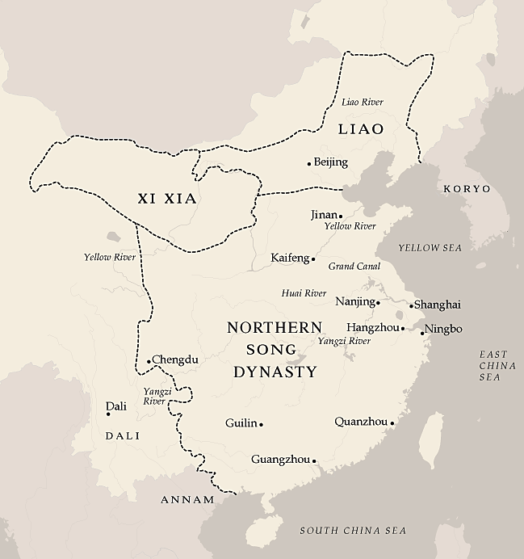
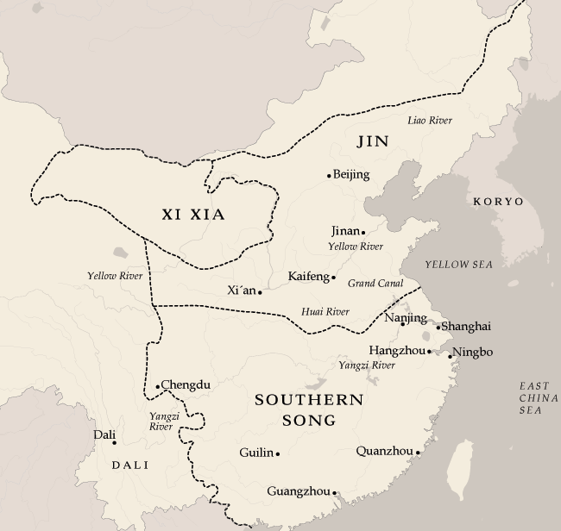

Slide 7
Why does this matter?
To connect the Qingming scroll to the tumultuous events of 12th cent...
we should try to be precise about when it was painted and what it represents!
Much of S. Song literati culture involves memoirs & nostalgia of N. Song, esp. Kaifeng
  Ex. Meng Yuanlao 孟元老, Dongjing menghua lu 東京夢華錄 / 东京梦华录
  “Glorious Dreams of the Eastern Capital,” 1147
Experience vs. memory/nostalgia vs. ‘cultural memory’
  How does time change what we remember, consider important?
  How do we think about & relate to eras we did not personally experience?
A painting is not a photograph...

Slide 8
One perspective: Hansen & ‘idealized city’
Hansen’s argument:
  Painting does not depict N. Song Kaifeng, but is instead an imaginary ideal city
  Most likely painted after fall of N. Song
Evidence:
  No prominent, well-identified landmarks: Ex. City gate not labeled
  Very little evidence of any Qingming Festival celebrations
  Inconsistent seasonal imagery
  Idealized: No poverty, understaffed watchtowers, few fortifications
  Style/technique reminiscent of other mid/late 12th century art, suggesting post-N. Song composition
So what?
  A nostalgic tribute to daily life in the N. Song, in an imaginary & idealized fictional city
  A visual counterpart to Meng Yuanlao’s memoir, but without precise details of Kaifeng life?
  An implicit critique of the current regime?

Slide 9
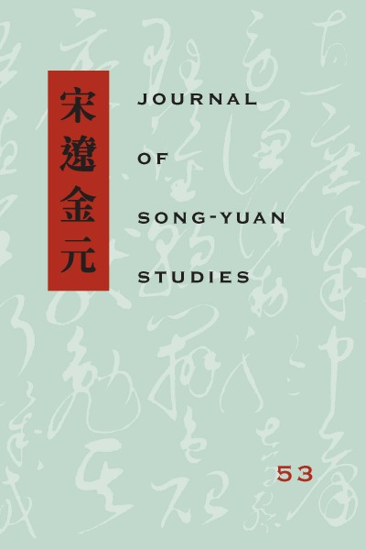
Tsao Hsingyuan: “Unraveling the Mystery of the Handscroll ‘Qingming shanghe tu’”
Argument:
  City depicted is Kaifeng
  Time of year: Around Qingming festival, but not concerned with holiday traditions
  Instead, theme is spring re-opening of river to trade
Significance: What is important to contemporary audiences may be forgotten in later times.

Slide 10
Review: Evidence & Analysis
The city represented is Kaifeng
  Primary wine shop / secondary wine shops: A large city with a thriving alcohol market
  A small, easily overlooked detail: “Meilu” wine, known to have been made in Kaifeng
Tsao’s main point: The time of year & annual event
  Qingming as 1 of 24 “solar terms” (calendar segments), early spring (not just holiday)
  Thawing of ice, reopening of canals
  Imagery focused on grain ships returning, bustling wine shops, warmer weather
Before 1079?
  In 1079, canals were re-routed, allowing for year-long transport of goods
  Qingming term no longer associated with re-opening of canals
  Later artists, writers, viewers, etc. gradually forget this detail

Slide 11
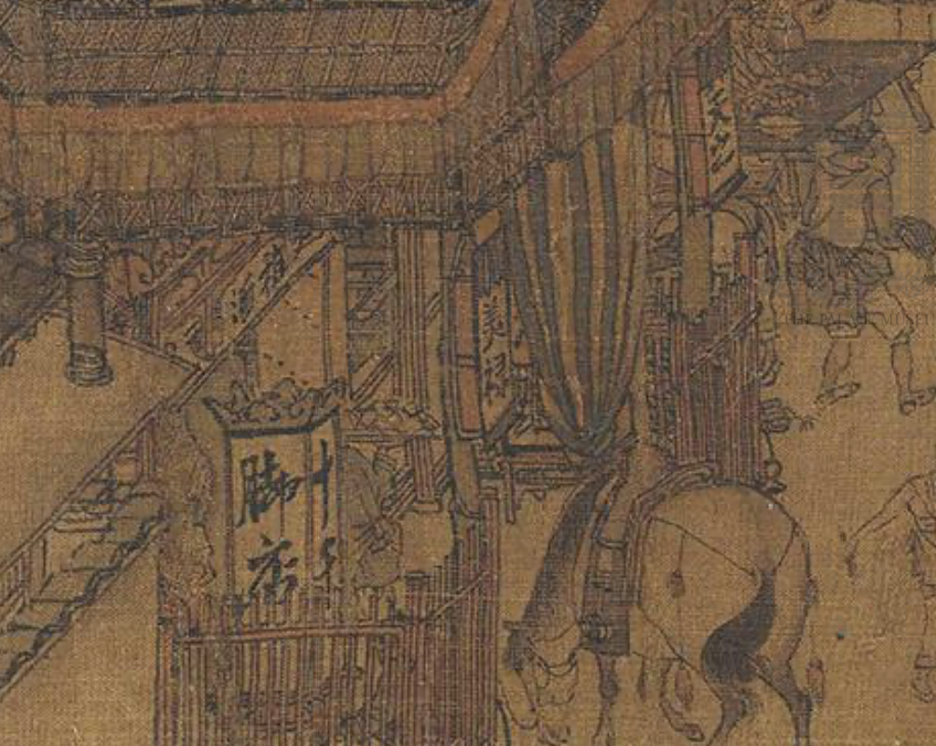
Review: Evidence & Analysis

Slide 12
Significance
Changing memory of Kaifeng
  Pre 1079, Qingming & reopening of river would be familiar “Kaifeng culture”
  Not mentioned by Meng Yuanlao, who lived in late 11th/early 12th cent. Kaifeng
  Dongjing menghua lu defines “N. Song Kaifeng” for later audiences
Legacy of Qingming scroll
  Later versions of Qingming scroll add even more detail directly from Meng’s memoirs
    The absence of many local landmarks in original becomes more conspicuous!
  But lose sight of original context of painting
    Perhaps for pre-1079 audience, this detail alone would be enough to signify Kaifeng
  Even later versions instead apply ‘Qingming’ theme to Ming/Qing cities
    What connects them to Zhang Zeduan’s original?
    Not reopening river or even Kaifeng imagery, but general theme of prosperous & peaceful city

Slide 13
One more perspective...
Yu Hui, National Palace Museum Beijing:
City depicted is Kaifeng, but the scroll criticizes N. Song Kaifeng, rather than praises it
Reinterpretation of details:
Lack of fortifications, guards
  The city is unprepared for Jin invasion
Wine shops and celebration
  Boisterous, but decadent, distracted
  The medicine stall marketing “hangover cures” at the scroll’s end...
Many ships carrying goods
  Prosperous, perhaps, but Yu Hui notes that they are private ships, not government-owned
  Emperor Huizong criticized for monopolizing imperial fleet for his own hobbies & leisure

Slide 14
So what?
Who is right? Who is wrong?
  All make persuasive points. Is there any ‘definitive’ evidence?
  Debate will likely continue, new arguments will be made
  Those concerned with Zhang Zeduan’s original must focus on that painting itself, Song-era context, not the overwhelming legacy of later versions, popular understanding.
So the later versions don’t matter?
  Of course they do!
  Whatever unresolved questions we have about Zhang Zeduan’s painting...
  ...the ‘idea’ of the Qingming scroll is established via these later works.
  They draw from Meng’s memoir of Kaifeng, later artists’ own ideas & experiences, details from other cities, other periods of history, and more...

Slide 15
Assignment & Quiz details
Tsao’s argument is based on the idea that an event immediately recognizable to one generation may be forgotten by the next. Can you think of an image of some event or cultural phenomenon, etc. that is instantly familiar to your parents’ generation, but which you don’t understand without their explanation? What about an image of something from your own lifetime that might soon become similarly confusing for later generations? What additional documentation would be necessary to make sure the image remained intelligible? Write a short explanation, with reference to how this relates to Tsao’s argument.
Quiz: 5 questions, 10 minutes to complete. Will address details of all 3 perspectives mentioned in today’s lecture, with more attention given to details from Tsao’s article. You will not be asked to decide if Tsao, Hansen, or Yu is right, but you should try to understand the rationale behind all three perspectives.

Slide 16
Additional reading
Hansen, Valerie. “The Mystery of the Qingming Scroll and its Subject: The Case Against Kaifeng.” Journal of Song-Yuan Studies 26 (1996): 183–200.
West, Stephen H. “The Interpretation of a Dream: The Sources, Evaluation, and Influence of the Dongjing meng Hua lu.” T’oung Pao 71.1/3 (1985): 63–108.
Yu Hui 余晖. Yinyou yu qujian: ‘Qingming shanghe tu’ jiemalu 隐优与曲谏：《清明上河图》解码录 (Hidden Concern and Subtle Critique: Decoding the Going Upriver on the Qingming Festival Scroll). Peking University Press, 2015.
  Yu Hui’s analysis of the Qingming scroll is only available in Chinese. It is summarized in English in McCausland, The Art of the Chinese Picture Scroll p. 54- 55.

